Slide 1
Lesson objective
Need whiteboards and Calculators
Title: Experimental Vs theoretical probability
Aim:
Describe the difference between experimental and theoretical probability.
Assign probability after an experiment
Plan:
Review Perimeter, Area and Volume
Exp Vs Theoretical
Notes page

Slide 2
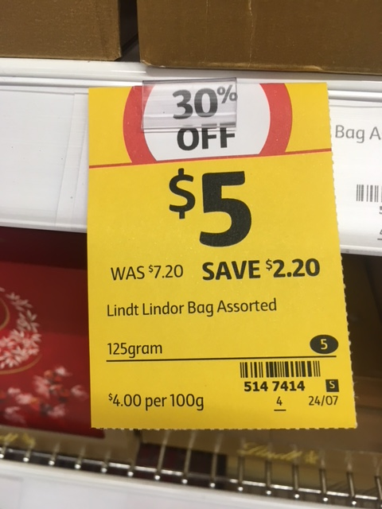
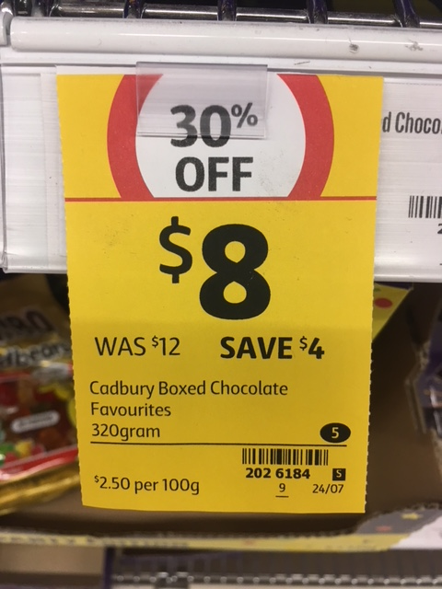













Comparing prices for the same quantity
$$cost÷quantity$$
Found in shops for value comparisons
This calculation always involves
It is usually given as $ per 100 grams
It is sometimes given as $ per 1 kilogram
‘per’ means ‘for every’
$$\$8÷320g$$
$=\$0.025$ per gram
$$\$5÷125g$$
$=\$0.04$ per gram
$$\$0.025×100$$
$=\$2.50$ per 100 grams
$$\$0.04×100$$
$=\$4$ per 100 grams
$$\$0.025×1000$$
$=\$25.00$ per 1 kilogram
$$\$0.04×1000$$
$=\$40.00$ per 1 kilogram

Slide 3
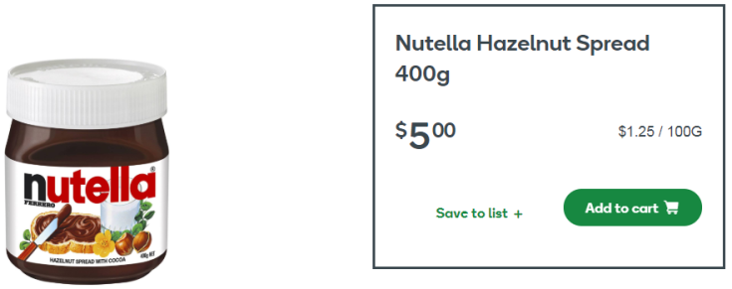
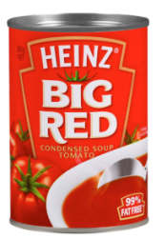
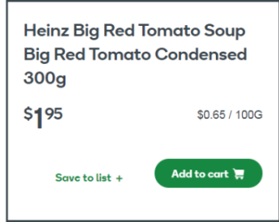
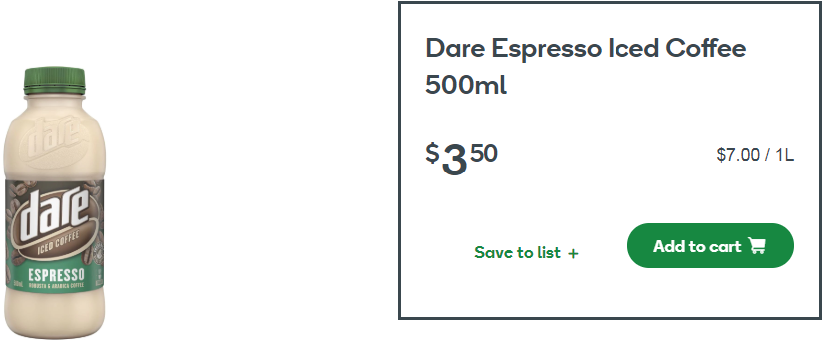
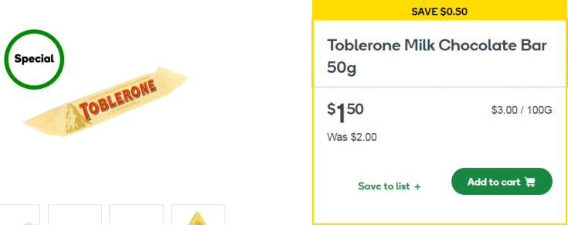







Calculate prices for the same quantity
Practice:
$$cost÷quantity$$
The first is done for you:
Item | Cost per gram | Cost per 100g | Cost per kilogram
$$\$5÷400g$$
$$\$0.0125×100$$
$$\$0.0125×1000$$
$=\$0.0125$ per gram
$=\$1.25$ per 100g
$=\$12.50$ per 1 kg

Slide 4
Answers are on the following slide…

Slide 5


















Calculate prices for the same quantity
Practice:
$$cost÷quantity$$
The first is done for you:
Item | Cost per gram | Cost per 100g | Cost per kilogram
$$\$5÷400g$$
$$\$0.0125×100$$
$$\$0.0125×1000$$
$=\$0.0125$ per gram
$=\$1.25$ per 100g
$=\$12.50$ per 1 kg
$$\$1.95÷300g$$
$$\$0.0065×100$$
$$\$0.0065×1000$$
$=\$0.0065$ per gram
$=\$0.65$ per 100g
$=\$6.50$ per 1 kg
$$\$3.50÷500g$$
$$\$0.007×100$$
$$\$0.007×1000$$
$=\$0.007$ per mL
$=\$0.70$ per 100mL
$=\$7.00$ per 1 L
$$\$1.50÷50g$$
$$\$0.03×100$$
$$\$0.03×1000$$
$=\$0.03$ per gram
$=\$3.00$ per 100g
$=\$30.00$ per 1 kg

Slide 6
Perimeter is the boundary forming the shape
Calculate by Adding ALL the sides
Area is the space inside a 2D shape
Specific formula for different shapes
Volume is the amount of space inside a 3D shape
- Calculate using specific formula

Slide 7
Perimeter is the boundary forming the shape
Calculate by Adding ALL the sides
Area is the space inside a 2D shape
Specific formula for different shapes
Volume is the amount of space inside a 3D shape
- Calculate using specific formula

Slide 8
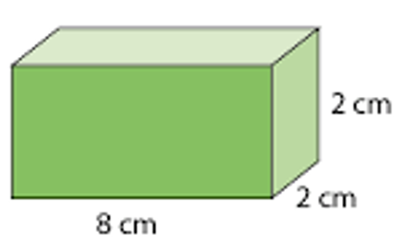
Perimeter (add all sides)
Area (use formula)
Volume (Use formula)
A = 0.5 x b x h
A = l x b x h
5cm
9cm
7cm
8cm
A = b x h
7cm
7cm
11cm
11cm

Slide 9
A = b x h
Perimeter and area
A = 0.5 x b x h
25mm
12m
15mm
22mm
20m

Slide 10
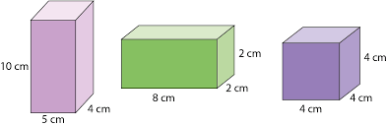

Slide 11
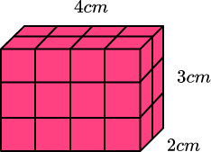
Whiteboards
9m
Volume?
A = b x h
15m
15m
10m
12m
14m
A = 0.5 x b x h

Slide 12
The difference
Theoretical probability
What is expected to occur as a result of an experiment/trial – as a fraction.
(What we think should happen)
Experimental probability
The number of times that it occurred when the experiment was conducted. (What actually happens)

Slide 13
The difference
Theoretical probability
What is expected to occur as a result of an experiment/trial – as a fraction.
(What we think should happen)
Experimental probability
The number of times that it occurred when the experiment was conducted. (What actually happens)

Slide 14
Vocabulary
Probability – expressed as a ratio describing the # of ________ outcomes to the # of ________ outcomes. Probability is measured on a scale from 0 – 1.
Theoretical probability – the probability, based on ________, that an event will occur. (what should happen)
Experimental probability – found using outcomes obtained in an actual __________ or game (what actually happens)
favorable
total
Math
experiment

Slide 15
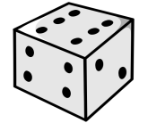
TRIAL #2: Rolling a Number Cube Out of 20 trials, how many times will an odd number occur– P (odd #)?
What do we need to know? # of odd #’s: _____ total # of sides: _____ | 2) Theoretical Probability:
Do the experiment (20 trials): | 4) Experimental Probability:
(what should happen)
(what actually happens)
Notes:
If you have a dice available at home, roll it 20 times and record your results. How many odd numbers did you land on out of 20 rolls?
Make sure you always amount of favourable outcomes over the number of possible outcomes.

Slide 16

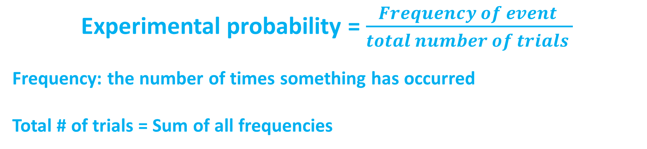
$$P\left(event\right)= \frac{Number of favourable outcomes}{Total \# of outcomes}$$
Experimental probability = $\frac{Frequency of event }{total number of trials }$
Frequency: the number of times something has occurred
Total # of trials = Sum of all frequencies

Slide 17

Identifying the frequency and the # of trials
Joe cast his line in 34 times, he caught 18 fish.
What is the probability of Joe catching a fish on his next cast?
P(fish) = $\frac{18}{34 }$
Number of trials
Frequency

Slide 18
Exercise books: SKETCH TABLE
whiteboards
Counting types of cars coming into a parking zone, Tommy counted 10 red cards, 22 white cars, 5 blue cars and 3 black cars.
What is the experimental probability for each coloured car?
What is the probability of the next car being red?
Car colour | Frequency | Experimental probability

Slide 19
Continue with activity sheet

Slide 20
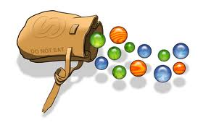






SAMPLE Probability Questions:
A bag contains 7 blue, 5 purple, 12 red, and 6 orange marbles. Find each probability if you draw one marble at random from the bag. Write as a fraction in simplest form.
a) P(purple) b) P(red or orange) c) P(not blue)
You roll a standard number cube (six sides numbered 1 – 6). After one roll, answer the following:
a) P(3 or 4) b) P(even #) c) P(not 2)
$\frac{5 }{30 }$ or $\frac{1}{6}$
$\frac{18 }{30 }$ or $\frac{3}{5}$
$$\frac{23 }{30 }$$
$\frac{2 }{6 }$ or $\frac{1}{3}$
$\frac{3 }{6 }$ or $\frac{1}{2}$
$$\frac{5 }{6 }$$
Notes:
Try answering these before veiwing the answers

Slide 21
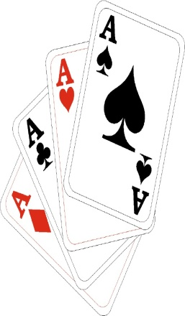




Fill in the following information about a standard deck of cards:
TOTAL # of Cards: _____
# of Hearts(♥): _____
# of Diamonds(♦): _____
# of Clubs(♣): _____
# of Spades(♠): _____
# of Red Cards: _____
# of Black Cards: _____
Cards in Each Suit: _______
Now, given the above, answer the following:
a) P(Ace) b) P(red card) c) P(Red King) d) P(Club)
13
$\frac{4 }{52 }$ or $\frac{1}{13}$
$\frac{26 }{52 }$ or $\frac{1}{2}$
$\frac{2 }{52 }$ or $\frac{1}{26}$
$\frac{13 }{52 }$ or $\frac{1}{4}$

Slide 22
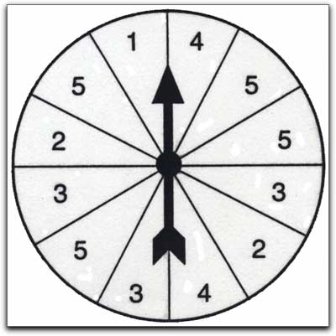
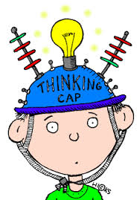



Given the spinner to the right, answer the following:
a) P(5) b) P(odd #) c) P(2 or an odd #)
$\frac{4 }{12 }$or $\frac{1}{3}$
$\frac{8 }{12 }$or $\frac{2}{3}$
$\frac{10 }{12 }$or $\frac{5}{6}$

Slide 23



Sample “Experimental” Probability Questions:
Mike was practicing basketball shots. Out of 24 attempts, he made 21 baskets. Based on this rate, what is the probability that Mike’s next shot will go in the basket?
Jane was throwing darts. Out of 12 attempts, 3 were bulls-eyes. If Jane were to make 36 attempts, how many should be bulls-eyes?
$\frac{21}{24 }$ or $\frac{7}{8}$
9

Slide 24

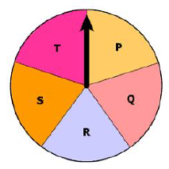
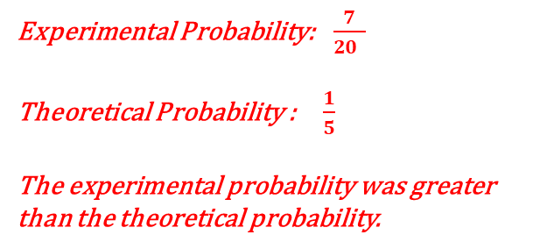
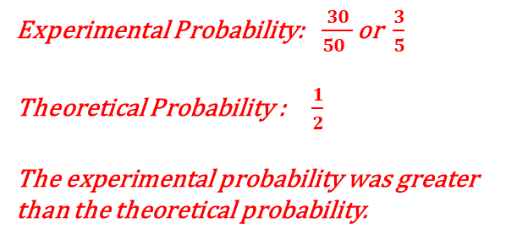
A coin was flipped fifty times. Out of 50, it landed on heads 30 times. What is the experimental probability that the coin will land on heads on the next toss? How is this different from the theoretical probability?
Experimental Probability:$\frac{30}{50 }$ or $\frac{3}{5}$
Theoretical Probability : $\frac{1}{2}$
The experimental probability was greater than the theoretical probability.
The spinner shown has 5 sections of equal size. The arrow of this spinner was spun 20 times and landed on the section labeled “R” 7 times. Compare the theoretical probability with the experimental probability of the spinner landing
on “R.”
Experimental Probability:$\frac{7}{20 }$
Theoretical Probability : $\frac{1}{5}$
The experimental probability was greater than the theoretical probability.

Slide 25
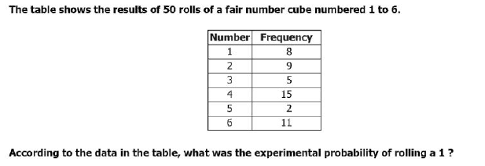
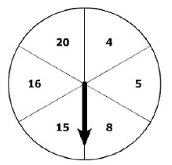


The table shown depicts the results of 50 rolls of a fair number cube numbered 1 – 6. According the table, what was the experimental probability of rolling a 3 ?
The arrow of this spinner was spun 40 times.
On 25 out of 40 times, the arrow landed on a
section labeled with a multiple of 4. What was
the experimental probability of the arrow
landing on a section labeled with a multiple
of 4?
$\frac{5}{50 }$ or $\frac{1}{10}$
$\frac{25}{40 }$ or $\frac{5}{8}$

Slide 26
SAMPLE Probability Questions:
A bag contains 7 blue, 5 purple, 12 red, and 6 orange marbles. Find
each probability if you draw one marble at random from the bag. Write as a fraction in simplest form.
a) P(purple) b) P(red or orange) c) P(not blue)
2) You roll a standard number cube (six sides numbered 1 – 6). After one roll, answer the following:
a) P(3 or 4) b) P(even #) c) P(not 2)
Fill in the following information about a standard deck of cards:
TOTAL # of Cards: _____
# of Hearts(♥): _____
# of Diamonds(♦): _____
# of Clubs(♣): _____
# of Spades(♠): _____
# of Red Cards: _____
# of Black Cards: _____
Cards in Each Suit: _______
Now, given the above, answer the following:
a) P(Ace) b) P(red card) c) P(Red King) d) P(Club)
Given the spinner to the right, answer the following:
a) P(5) b) P(odd #) c) P(2 or an odd #)

Slide 27
Sample “Experimental” Probability Questions:
Mike was practicing basketball shots. Out of 24 attempts, he made 21 baskets.
Based on this rate, what is the probability that Mike’s next shot will go in the basket?
Jane was throwing darts. Out of 12 attempts, 3 were bulls-eyes. If Jane were to make 36 attempts, how many should be bulls-eyes?
A coin was flipped fifty times. Out of 50, it landed on heads 30 times. What is the experimental probability that the coin will land on heads on the next toss? How is this different from the theoretical probability?
The spinner shown has 5 sections of equal size. The arrow of this spinner was
spun 20 times and landed on the section labeled “R” 7 times. Compare the
theoretical probability with the experimental probability of the spinner landing
on “R.”
The table shown depicts the results of 50 rolls of a fair number cube
numbered 1 – 6. According the table, what was the experimental probability of
rolling a 3 ?
The arrow of this spinner was spun 40 times. On 25 out of 40 times, the arrow
landed on a section labeled with a multiple of 4. What was the experimental
probability of the arrow landing on a section labeled with a multiple of 4?

